Slide 1


FROM RESEARCH
TO IMPACT
BATT-BRIDGE and the skills
Europe needs for batteries
Silvia Bodoardo
Politecnico di Torino,
BATTERY DAY, E-TECH EUROPE
Bologna, 8 October 2026
Notes:
Good afternoon. In the next fifteen minutes I would like to make one simple point. Europe produces excellent battery research, but it must also make the resulting knowledge comparable, transferable and useful for industrial decisions. BATT-BRIDGE is building that connection, and GIGAGREEN gives us a concrete case on which to test it.
SOURCES:
- Official Battery Day 2026 agenda: https://e-tech.show/batter-day-agenda/
- Image and logo: assets from presentations provided by the user.

Slide 2
THE CHALLENGE
The bottleneck lies between knowledge and deployment
01
02
03
RESEARCH
SCALE-UP
INDUSTRY
results, data, new chemistries
process windows, quality, reproducibility
cost, volume, risk
EVIDENCE
DECISIONS
INVESTMENT
The bridge needs technology, data and skilled people.
BATT-BRIDGE × GIGAGREEN
02
Notes:
Our value chain produces excellent research, yet transfer often breaks down between a scientific result and an industrial decision. Evidence is rarely collected under comparable conditions. Laboratories and manufacturing teams often lack a shared language, and too few people can work confidently across both environments. The bridge therefore needs technology, data and people.

Slide 3
Global battery deployment continues to grow rapidly
Lithium-ion battery deployment by application
GWh
Electric vehicles
Battery storage
Portable electronics
Others
Total
Global lithium‑ion battery market grew by almost 30% in 2025.
EVs accounts for over 70%, while battery energy storage grew at the fastest pace – over 20-fold over the past 5 years.
Page 4

Slide 4
Three shifts are reshaping global car markets
Car sales by region
Car exports
Car sales by technology
Other EMDEs
China
Electric
European
Union
Hybrid
China
Japan
United States
Internal combustion engine
European Union
United States
Other advanced economies
Car production in China has more than doubled between 2010 and 2024, when China overtook the European Union as the largest car exporter in the world.

Slide 5
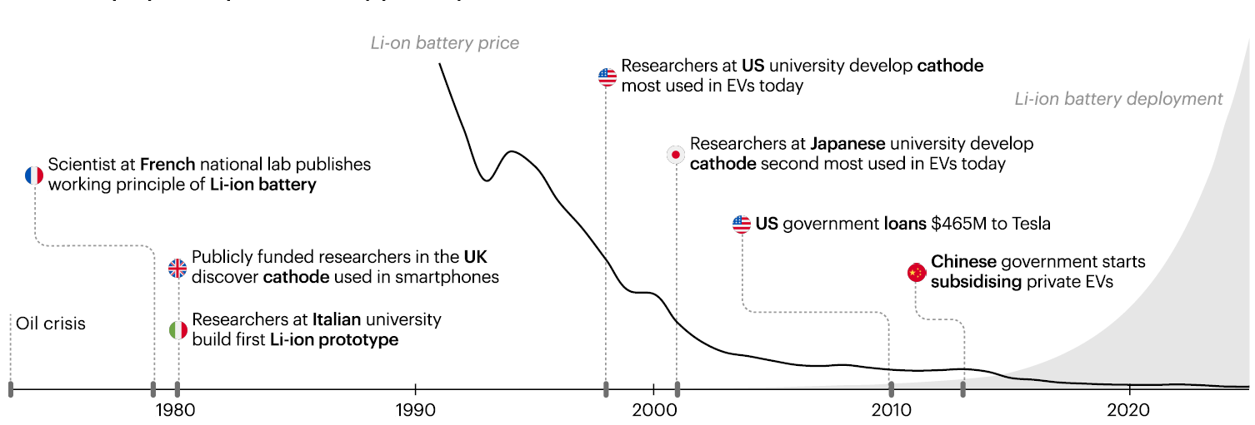
Public R&D is behind recent steps forward for energy technologies
Global deployment, price and key publicly-funded milestones for lithium-ion batteries, 1973-2025
Li-ion invention was underpinned by public funding and followed by many research successes in public laboratories.
Its annual market was worth over $150 billion in 2025.

Slide 6
EUROPEAN LANDSCAPE
One value chain, four connected layers
01
SET Plan, SRIA
strategic direction
ALIGNMENT
CREATES VALUE
02
Batt4EU, BEPA + European Commission
programme design and partnership
Priorities, data, people and investment follow the same path.
03
Projects, infrastructure, pilot lines
evidence and demonstration
↻
04
BATT-BRIDGE
connection, comparison and community
BATT-BRIDGE × GIGAGREEN
03
Notes:
The European landscape will already have been discussed this morning, so I will reduce it to one idea. Strategy, partnership programming, projects and coordination must work as one chain. The SET Plan and SRIA set the direction. Batt4EU translates it into programmes. Projects generate evidence, and BATT-BRIDGE reconnects that evidence to the community and the strategic agenda. Alignment creates the value.
SOURCES:
- SET Plan Thematic Vision on Batteries: https://bepassociation.eu/set-plan-thematic-vision-on-batteries-is-out/
- European Commission Battery Booster: https://commission.europa.eu/topics/competitiveness/competitiveness-coordination-tool-projects/battery-booster_en
- BATT-BRIDGE: https://batt-bridge.eu/

Slide 7



Legacy
BATT-BRIDGE combines two legacies
One shared Agora
Roadmaps and priorities
KPIs and observatory
Policy and industry dialogue
Long-term research
Scientific community
Early-career development and education

Slide 8
IDENTITY
BATT-BRIDGE in 30 seconds
2026–29
16 / 10
€3.0 M
three years to build
a sustainable Agora
partners / countries
Coordination and
Support Action
MISSION
A common entry point for evidence, opportunities and the Batt4EU community.
Coordinator: EIT InnoEnergy
BATT-BRIDGE × GIGAGREEN
05
Notes:
In numbers, BATT-BRIDGE is a Coordination and Support Action running from April 2026 to March 2029. It brings together 16 partners in 10 countries and receives about three million euros in EU funding. EIT InnoEnergy coordinates the action. Its mission is to increase the impact of the Batt4EU portfolio through a common entry point for knowledge, opportunities and community activity.
SOURCES:
- CORDIS BATT-BRIDGE, Grant 101268695: https://cordis.europa.eu/project/id/101268695/en
- BATT-BRIDGE: https://batt-bridge.eu/

Slide 9
The Agora
The project rests on two pillars
01
PLATFORM
Projects and results
KPIs and targets
Funding and calls
Roadmaps and strategies
02
COMMUNITY
Events and working groups
Co-design and surveys
Match making
Early-career community

Slide 10
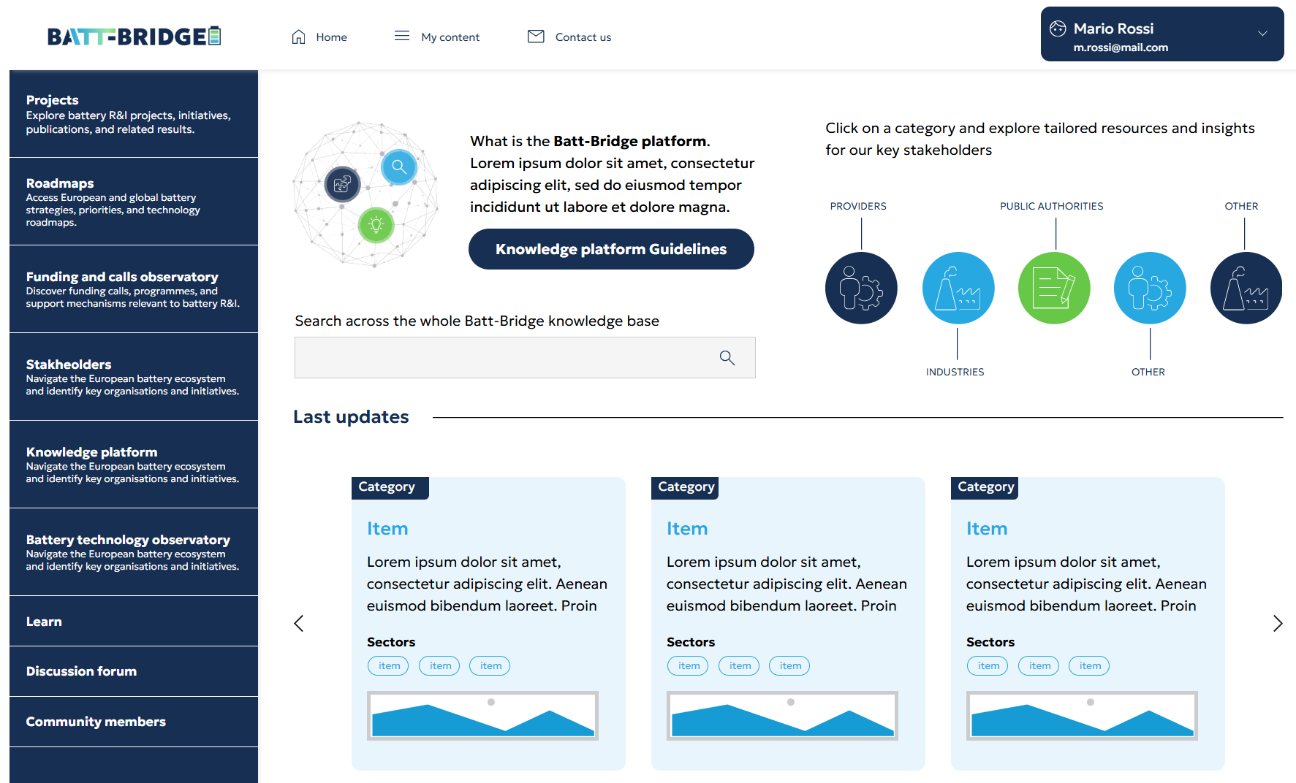
Platform
The Digital Platform*
  One entry point for European battery R&I knowledge
Searchable, structured environment for European and global battery R&I information
Connects information across research, industry, funding and policy
Supports comparison, analysis and evidence-based decisions
* Work in progress

Slide 11
Community
The BATT-BRIDGE Community
  Turning participation into outputs
PROJECTS
INDUSTRY
Results and needs
Scale-up and markets
BATT-BRIDGE
Community
RESEARCH
POLICY
Universities and RTOs
Priorities and Instruments

Slide 12
PLATFORM
Comparable data with the context attached
TECHNOLOGY PROFILE
COMPARABLE EVIDENCE
chemistry / technology
01
KPI + unit
TRL + MRL
02
level: material / cell / pack
application
03
measurement conditions
benefits and gaps
04
year and maturity
timeline and projects
05
source and method
BattINFO, FAIR DATA, OBSERVATORY + KPI DASHBOARD
Comparison requires context.
BATT-BRIDGE × GIGAGREEN
08
Notes:
The platform should support responsible comparison rather than rank technologies. Each technology profile needs the chemistry, application, TRL and MRL, benefits, gaps, timeline and related projects. Every KPI needs a unit, measurement level, conditions, year, maturity, source and method. BattINFO and FAIR principles provide continuity and help us avoid creating a competing taxonomy.
SOURCES:
- BATT-BRIDGE Digital Platform: https://batt-bridge.eu/digital-platform/
- BATT-BRIDGE platform feedback provided by the user, file 'Pasted markdown.md'.
- BattINFO / BIG-MAP: https://big-map.eu/

Slide 13

STRATEGIC AGENDA
Evidence shapes priorities, priorities guide new work
GAPS
RECOMMENDATIONS
PROJECTS
EVIDENCE
AGENDA
comparable KPIs
benchmarks and needs
research needs and briefs
results and data
SRIA, SET Plan, calls
feedback from practice
Continuous entry points
working groups, workshops, Annual Conference, Battery Innovation Days, surveys
A credible agenda shows the evidence behind each priority.
BATT-BRIDGE × GIGAGREEN
09
Notes:
This is BATT-BRIDGE's most strategic contribution. Projects generate data. The platform structures the evidence and comparisons reveal gaps and research needs. The community converts those findings into research-needs reports and policy briefs, which can inform the SRIA, the SET Plan and future calls. New priorities then return to the projects. A credible agenda lets us trace each priority back to evidence and keeps feedback from practice flowing.
SOURCES:
- BATT-BRIDGE Grant Agreement / proposal, file provided by the user.
- SET Plan Thematic Vision on Batteries: https://bepassociation.eu/set-plan-thematic-vision-on-batteries-is-out/
- BATT-BRIDGE: https://batt-bridge.eu/

Slide 14
SKILLS
Europe needs hybrid battery skills
01
02
03
04
05
MATERIALS
MANUFACTURING
DIGITAL
SUSTAINABILITY
TRANSFER
chemistry
electrochemistry
processes
quality
data, AI
digital twins, FAIR
LCA, TEA
SSbD, circularity
IP, business
finance, standards
T-shaped profiles connect the laboratory, pilot line and factory.
BATT-BRIDGE × GIGAGREEN
11
Notes:
The skills challenge calls for combinations rather than separate course lists. Materials and electrochemistry must connect with manufacturing and quality. Data, AI and digital twins must follow FAIR practices. Sustainability work needs LCA, TEA, safe and sustainable by design and circularity. Technology transfer also requires intellectual property, business, finance and standards. T-shaped profiles can connect the laboratory, pilot line and factory.
SOURCES:
- BATT-BRIDGE Grant Agreement / proposal, file provided by the user.
- European Commission Battery Booster: https://commission.europa.eu/topics/competitiveness/competitiveness-coordination-tool-projects/battery-booster_en

Slide 15

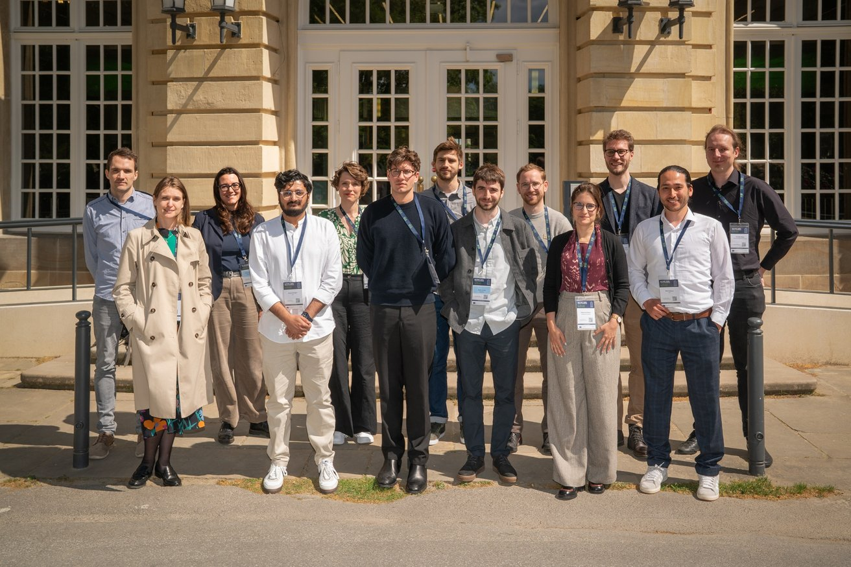

TALENT AND LINKS
Continuity depends on communities and career pathways
THREE LEVERS
01
early-career community
events, mentoring, project visibility
02
education and capacity
curricula, training, micro-credentials
03
international links
exchange of practices and opportunities
BATTERY 2030+ Young Scientist Community
BATT-BRIDGE × GIGAGREEN
12
Notes:
Continuity across the value chain depends on people. The early-career community created through BATTERY 2030+ should gain visibility and stronger links to mentoring, curricula, training and project opportunities. Internationally, the Faraday Institution provides a strong benchmark and a natural counterpart because it connects research, skills development, market analysis and early commercialisation. I present this as a relationship to strengthen, without implying that a formal partnership is already in place.
SOURCES:
- BATTERY 2030+ Education: https://battery2030.eu/education/activities/
- Faraday Institution: https://www.faraday.ac.uk/
- Image: asset from a presentation provided by the user.

Slide 16
There are strategies to bridge the competitiveness gap
Domestic lithium-ion battery production cost by region
Value creation from battery electric car production
100
Manufacturing
efficiency &
automation
Critical minerals
Cathodes & anodes
USD/kWh
Battery cells
80
Battery pack
Access to low-cost
components
60
Other
Assembled car
40
20
0
European Union
China
Most of the battery cost gap with China can be closed. Prioritising EV production now can boost domestic value and
battery demand, while supply chains are strengthened over time, both locally and with strategic partners.

Slide 17

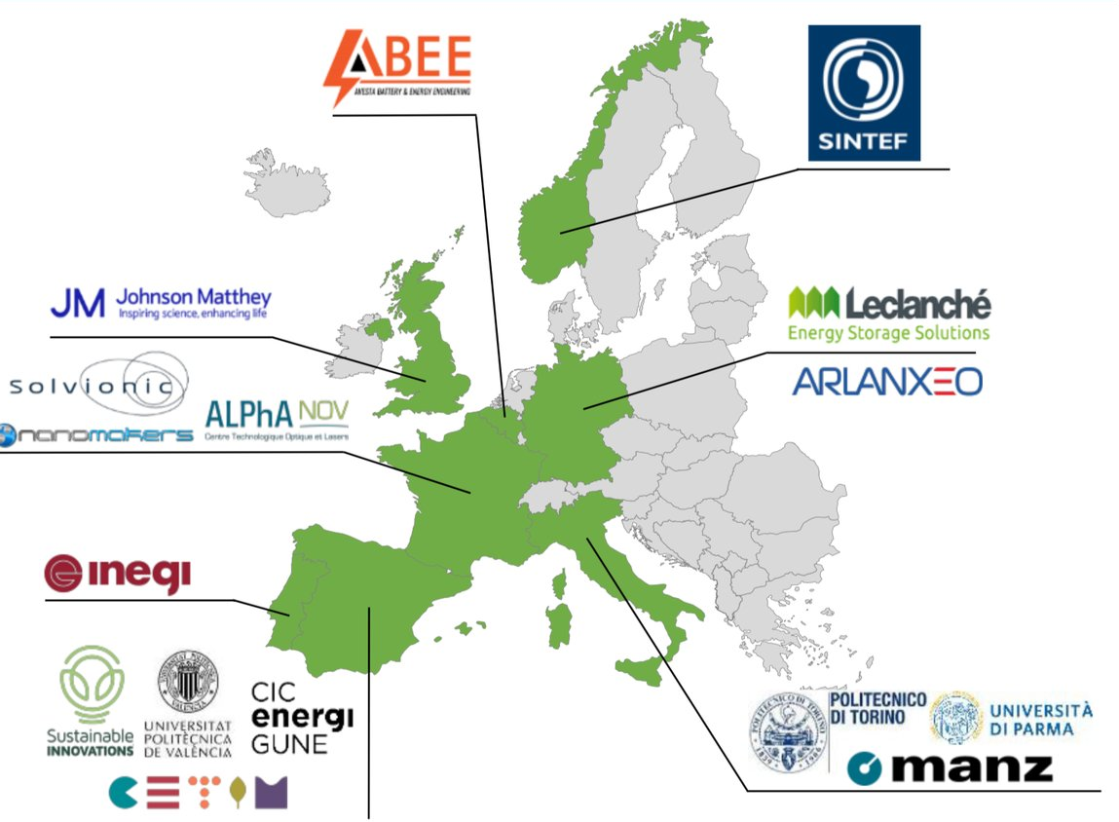
USE CASE
GIGAGREEN: design for manufacturing
Towards the sustainable gigafactory: developing green cell manufacturing processes
2022–2026
Politecnico di Torino
coordinator
TRL 3–4
TRL 5–6
WET
water-based, NMP-free process TRL 6
DRY
dry processing TRL4
The outcome includes a transferable manufacturing process.
HORIZON-CL5-2021-D2-01-04
Environmentally sustainable processing techniques applied to large scale electrode and cell component manufacturing for Li-ion batteries (Batteries Partnership)
BATT-BRIDGE × GIGAGREEN
13
Notes:
GIGAGREEN provides the concrete use case. Coordinated by Politecnico di Torino, it moves manufacturing technologies from TRL 3 to 4 towards TRL 5 to 6 through a Design to Manufacture approach. The project follows two routes: a water-based wet process without NMP and a dry process. The goal covers the cell and the manufacturing evidence needed for a transferable, scalable and automatable process.
SOURCES:
- CORDIS GIGAGREEN, Grant 101069707: https://cordis.europa.eu/project/id/101069707
- GIGAGREEN: https://gigagreenproject.eu/
- Image: asset from a presentation provided by the user.

Slide 18
FROM PROJECT TO UPTAKE
What the bridge needs to carry
PROJECT TARGETS
+10%
−25%
−20%
0%
GIGAGREEN
manufacturing
evidence
productivity
energy + carbon
costs
VOC
01
02
03
04
05
PROCESS WINDOW
AUTOMATION
DIGITAL TWIN
LCA + TEA
SKILLS + STANDARDS
reproducibility and tolerances
quality and in-line control
reusable data and models
verifiable impact and cost
people and a shared language
BATT-BRIDGE makes this evidence visible, comparable and reusable.
BATT-BRIDGE × GIGAGREEN
14
Notes:
The project targets include ten per cent higher productivity, twenty-five per cent lower energy use and carbon footprint, twenty per cent lower costs and zero VOC. Crossing the bridge requires evidence packages around process windows, reproducibility, automation and quality, digital-twin data, LCA and TEA, skills and standards. BATT-BRIDGE can make this evidence visible, comparable and reusable across projects and industry.
SOURCES:
- GIGAGREEN, project targets: https://gigagreenproject.eu/
- CORDIS GIGAGREEN results: https://cordis.europa.eu/project/id/101069707/results
- BATT-BRIDGE Digital Platform: https://batt-bridge.eu/digital-platform/

Slide 19



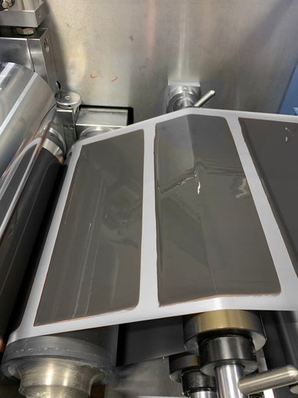











Roadmap
Material research and optimization
LMNO – Si rich
Manufacturing
Wet process in pilot line
Dry process
Gen1 monolayer cells
Scale up to 10 Ah cell
Selection of suitable binders
Evaluation of properties of interest for electrode manufacturing (i.e. rheology, EC stability…)
Formulation, testing and scale-up assessment for industrial production
Reseach and optimization of sustainable and ultra safe electrolyte
laser - texturing of electrodes
Digital Twin platform

Slide 20
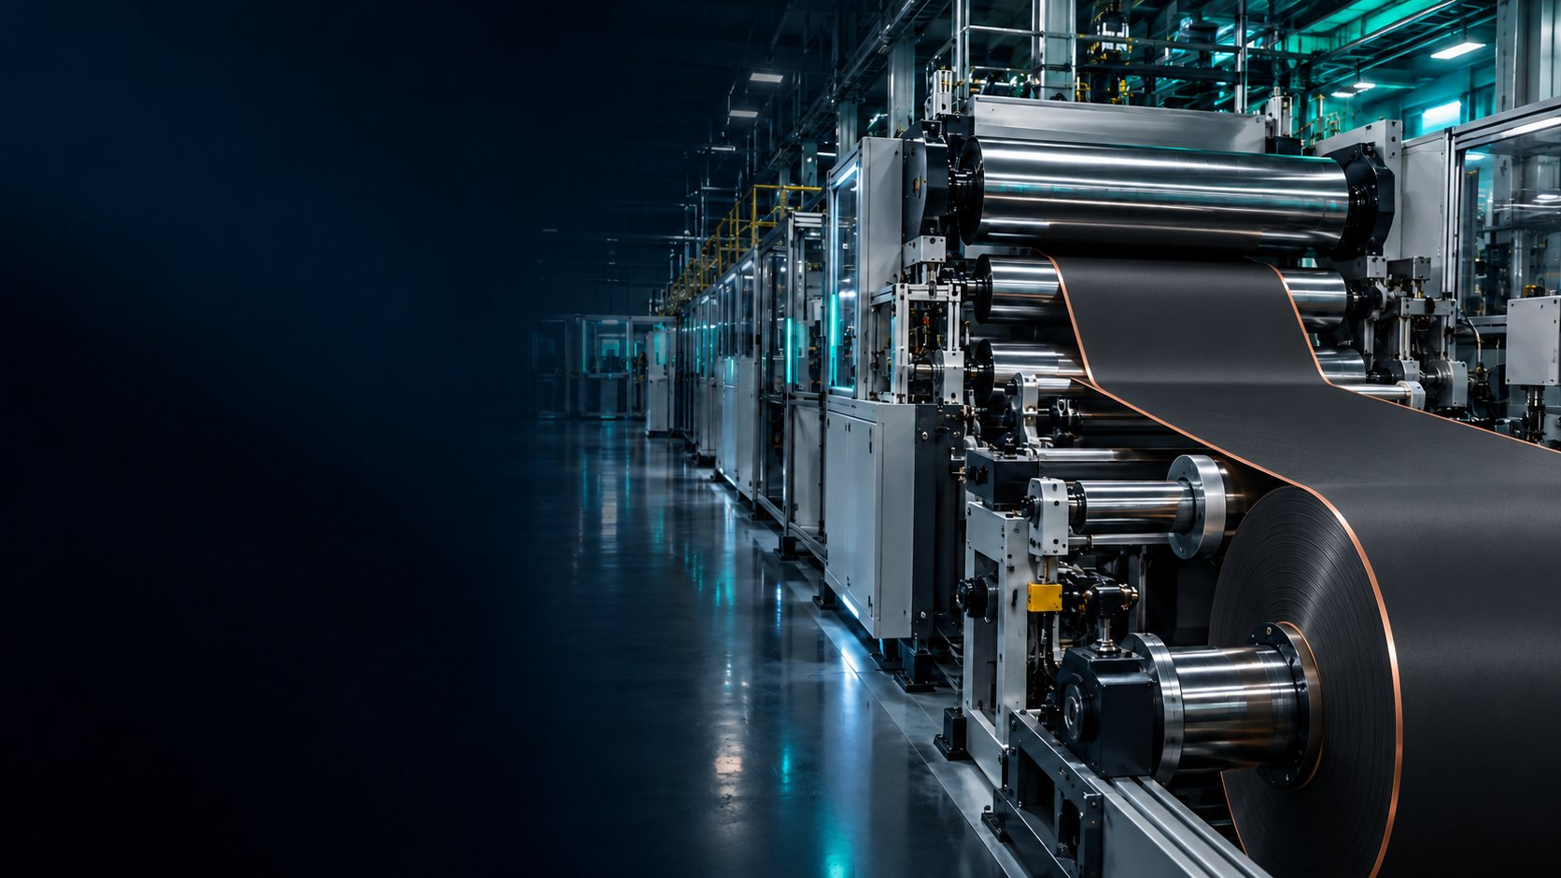

GIGAGREEN FINAL WORKSHOP +
EU POLICY DIALOGUE
BEYOND THE
PRELIMINARY PROGRAMME
PILOT LINE
What will it take to manufacture batteries competitively in Europe?
Project evidence meets industrial reality to shape Europe’s next battery manufacturing agenda.
24 NOVEMBER 2026
EERA premises
Rue de Namur 72
BRUSSELS + ONLINE
09:00–12:30
gigagreenproject.eu
Notes:
ANNUNCIO SUGGERITO (25–30 secondi)
Il 24 novembre a Bruxelles chiuderemo GIGAGREEN con un workshop che vuole andare oltre la presentazione finale del progetto. Metteremo a confronto progetti europei, industria e Commissione su una domanda molto concreta: che cosa manca tra una buona pilot line e una produzione competitiva in Europa? Il programma è ancora in costruzione, ma l’ambizione è chiara: trasformare i risultati dei progetti in una vera agenda europea per il manufacturing delle batterie. Sarà possibile partecipare anche online.
SOURCES
Provisional agenda supplied by the organiser.
GIGAGREEN project: https://gigagreenproject.eu/
Official logo: asset from a presentation supplied by the user.
Hero image: generated specifically for this workshop teaser slide.

Slide 21
CONCLUSION
Three choices that move research towards industrial impact
01
Make evidence comparable
BATT-BRIDGE
KPIs with context, TRL + MRL, sources and method
EVIDENCE
02
Bring manufacturing constraints in earlier
↓
cost, quality, automation and scale within research
AGENDA
↓
03
Grow skills and community
INDUSTRIAL
CAPABILITY
hybrid pathways, early-career community, international links
THANK YOU
Make impact traceable, shareable and ready for use.
batt-bridge.eu gigagreenproject.eu
BATT-BRIDGE × GIGAGREEN
15
Notes:
I will close with three choices. Make evidence comparable. Bring manufacturing constraints into research much earlier. Grow skills and a community that can connect disciplines and maturity levels. BATT-BRIDGE can then link evidence, the strategic agenda and industrial capability. GIGAGREEN can contribute a result that the wider ecosystem can reuse. Thank you.
SOURCES:
- BATT-BRIDGE: https://batt-bridge.eu/
- GIGAGREEN: https://gigagreenproject.eu/

